Slide 1





Probability

Slide 2
Probability
Probability is the way of expressing knowledge
of belief that an event will occur on chance.

Slide 3



Basic types of probability:
Type 1
Type 2
Type 3
Classic probability
Empirical probability
Axiomatic probability

Slide 4







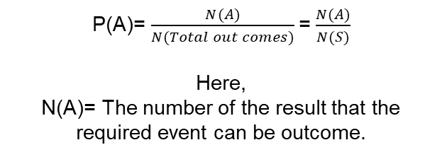
Basic types of probability:
Classic probability
01
P(A)= $\frac{N(A)}{N(Total out comes)}$=$\frac{N(A)}{N(S)}$
Here,
N(A)= The number of the result that the required event can be outcome.

Slide 5
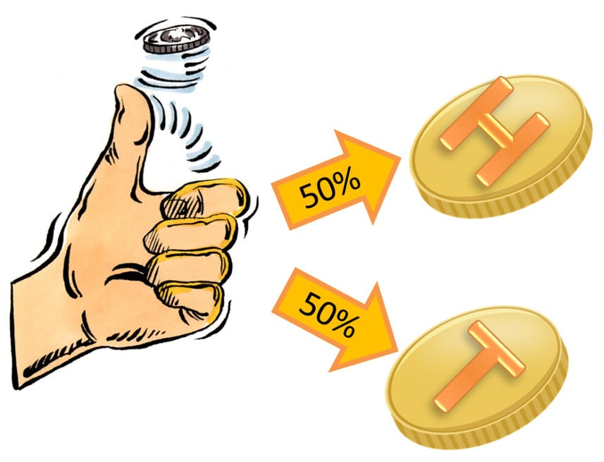
Tossing coin
`
If a coin tossed for a single time what is the probability of getting head?
What is the probability of getting tails at least once if a coin is flipped three times?

Slide 6

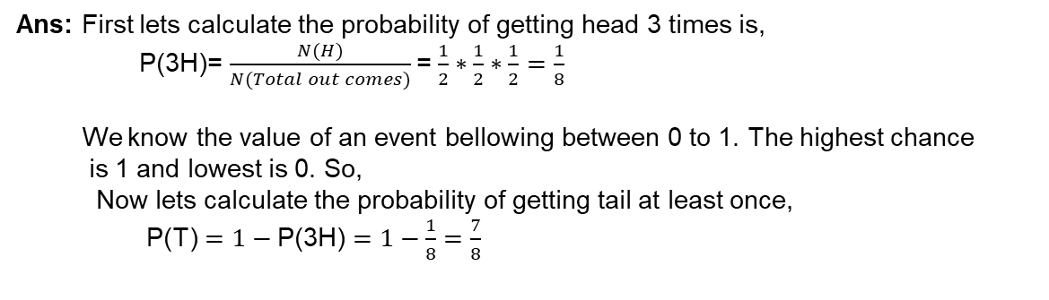
Survey questions with answer.
1: If a coin tossed for a single time what is the probability of getting head?
Ans: P(H)= $\frac{N(H)}{N(Total out comes)}$=$\frac{1}{2}$
2: What is the probability of getting tails at least once if a coin is flipped three times?
Ans: First lets calculate the probability of getting head 3 times is,
P(3H)= $\frac{N(H)}{N(Total out comes)}$=$\frac{1}{2}∗\frac{1}{2}∗\frac{1}{2}=\frac{1}{8}$
We know the value of an event bellowing between 0 to 1. The highest chance
is 1 and lowest is 0. So,
Now lets calculate the probability of getting tail at least once,
P(T) $=1−\text{P}\text{(3}\text{H}\text{)}=1−\frac{1}{8}$ $=$ $\frac{7}{8}$

Slide 7
Dice throwing
`
What is the probability of getting number 6 for a single time dice throwing?
What is the probability of getting even numbers for a single time dice throwing?

Slide 8
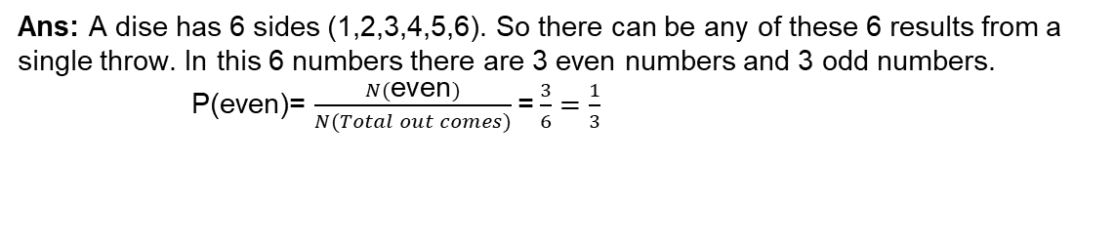
Survey questions with answer.
1: What is the probability of getting number 6 for a single time dice throwing?
Ans: A dise has 6 sides (1,2,3,4,5,6). So there can be any of these 6 results from a single throw.
P(6)= $\frac{N(6)}{N(Total result)}$=$\frac{1}{6}$
2: What is the probability of getting even numbers for a single time dice throwing?
Ans: A dise has 6 sides (1,2,3,4,5,6). So there can be any of these 6 results from a single throw. In this 6 numbers there are 3 even numbers and 3 odd numbers.
P(even)= $\frac{N(\text{even})}{N(Total out comes)}$=$\frac{3}{6}=\frac{1}{3}$

Slide 9

Basic types of probability:
Empirical probability
02
P(A)= $\frac{Number of times \left(A\right) occured}{Number of repetation}$

Slide 10

Ball in the jar
For example in a jar there are total 10 balls. From them 7 is red and rest of them are white.
What is the probability if we picked one ball from the jar and the colour will be red?
If we pick two balls one by one without replacement what is the probability to get first ball white and second one is red?

Slide 11
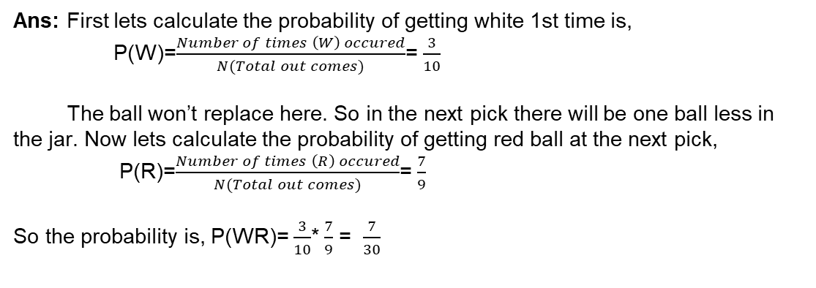
Survey questions with answer.
1:What is the probability if we picked one ball from the jar and the colour will be red?
Ans: P(R)= $\frac{Number of times \left(R\right) occured}{N(Total out comes)}$=$\frac{7}{10}$
2: If we pick two balls one by one without replacement what is the probability to get first ball white and second one is red?
Ans: First lets calculate the probability of getting white 1st time is,
P(W)=$\frac{Number of times \left(W\right) occured}{N(Total out comes)}$=$\frac{3}{10}$
The ball won’t replace here. So in the next pick there will be one ball less in the jar. Now lets calculate the probability of getting red ball at the next pick,
P(R)=$\frac{Number of times \left(R\right) occured}{N(Total out comes)}$=$\frac{7}{9}$
So the probability is, P(WR)= $\frac{3}{10}$*$\frac{7}{9}$ = $\frac{7}{30}$

Slide 12

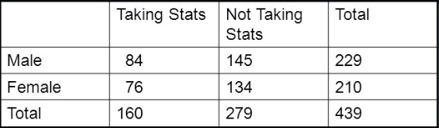
Table problem
Find the probability of selecting a male taking statistics from the population described in the following table:

Slide 13
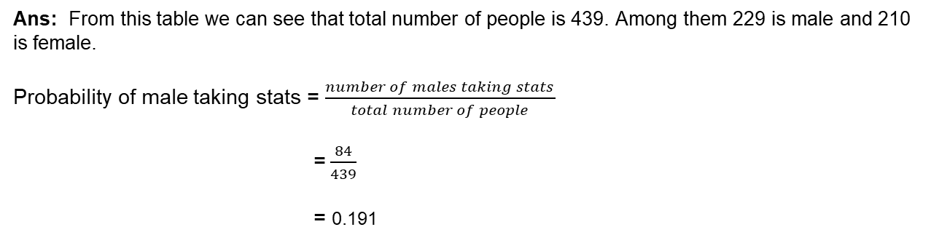
Survey questions with answer.
Find the probability of selecting a male taking stats from the population described in the following table:
Ans: From this table we can see that total number of people is 439. Among them 229 is male and 210 is female.
Probability of male taking stats = $\frac{number of males taking stats}{total number of people}$
=$\frac{84}{439}$
= 0.191

Slide 14
Basic types of probability:
Axiomatic probability
03
0≤ P(A) ≤ 1
P(S) = 1
P(A∪B)= P(A)+ P(B) [If A and B are disjoint]
or, P(A∪B)= P(A)+ P(B)-P(A∩B) [If A and B are not disjoint]

Slide 15



Difference between disjoint & not disjoint set
A = { 1,2,3}; B = {4,5,6}; C = { 1,3,5};
Here A & B are disjoint set and A & C are not disjoint set.

Slide 16
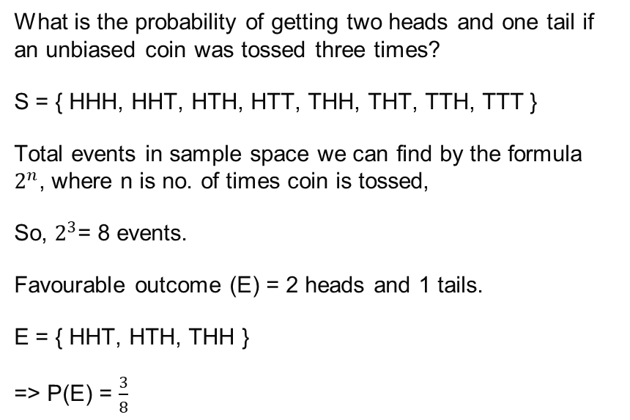
Coin toss
What is the probability of getting two heads and one tail if an unbiased coin was tossed three times?
S = { HHH, HHT, HTH, HTT, THH, THT, TTH, TTT }
Total events in sample space we can find by the formula $2^{n}$, where n is no. of times coin is tossed,
So, $2^{3}$= 8 events.
Favourable outcome (E) = 2 heads and 1 tails.
E = { HHT, HTH, THH }
=> P(E) = $\frac{3}{8}$

Slide 17
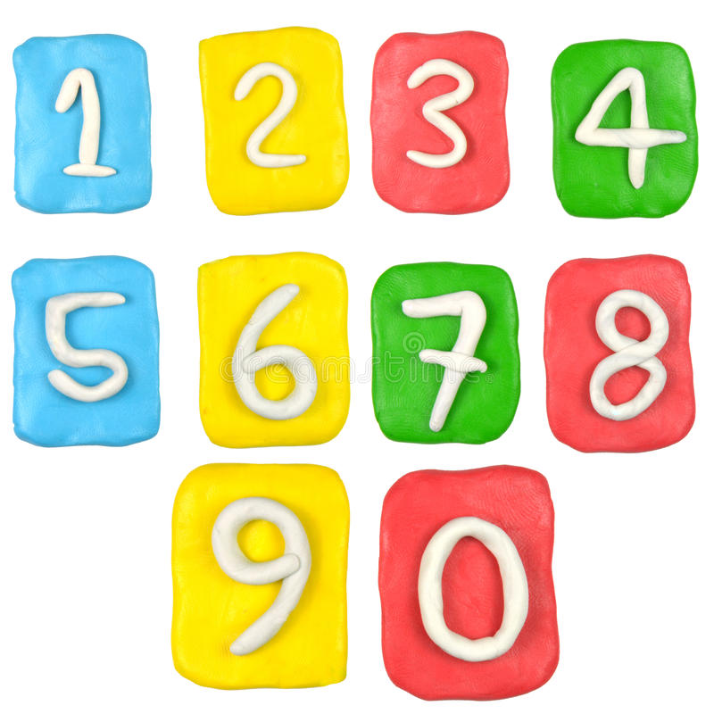
Set of numbers
Here 4 different sets are given below. Where S in the sample set
S = { 1,2,3,4,5,6}
A = { 1,2,3}
B = {4,5,6}
C = { 1,3,5}
Find:
i)P(A∪B) ii)P(A∪C)

Slide 18
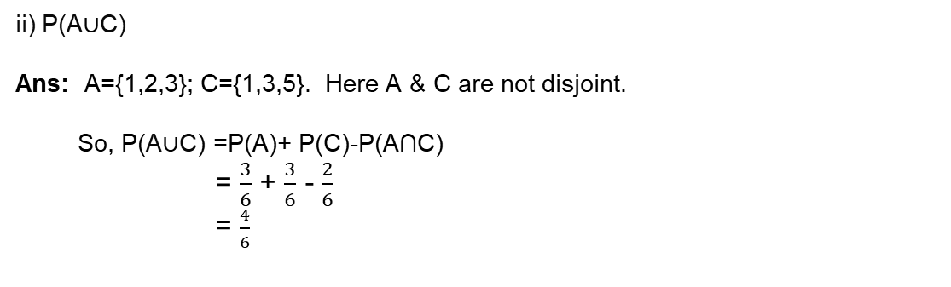
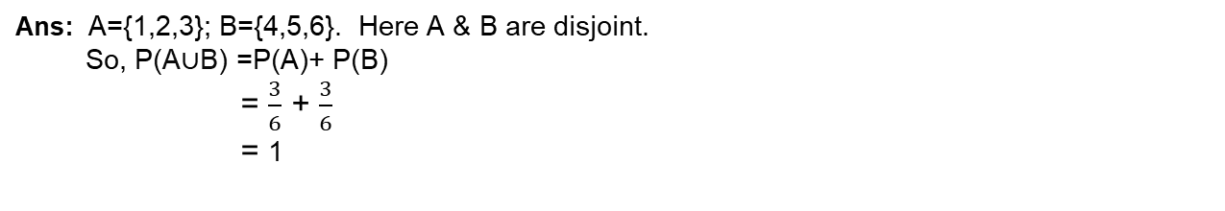
Survey questions with answer.
i) P(A∪B)
Ans: A={1,2,3}; B={4,5,6}. Here A & B are disjoint.
So, P(A∪B) =P(A)+ P(B)
= $\frac{3}{6}$ + $\frac{3}{6}$
= 1
ii) P(A∪C)
Ans: A={1,2,3}; C={1,3,5}. Here A & C are not disjoint.
So, P(A∪C) =P(A)+ P(C)-P(A∩C)
= $\frac{3}{6}$ + $\frac{3}{6}$ - $\frac{2}{6}$
= $\frac{4}{6}$

Slide 19

Thank You!

